Slide 1
Programming Fundamentals
Lecture 19

Slide 2
Objectives
Overloaded Functions
Inline Functions
Effect of inline functions on execution, compilation time and output file size
Recursive Functions

Slide 3
Types of User Defined Functions
The user defined functions can be divided in three main categories
Overloaded Functions
Recursive Functions
Inline Functions

Slide 4
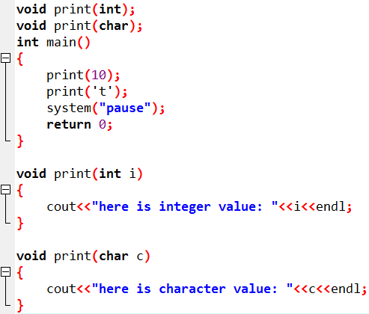
Overloaded Functions
An overloaded function is the one which is declared more than once with the same name in the same scope

Slide 5
How the Correct Function is Chosen?
When the overloaded functions are present in the program then compiler can differentiate between them by looking at:
Number of Parameters
Data Type of Parameters
We can not overload function declarations that differ only by return type
See the example codes for better understanding

Slide 6
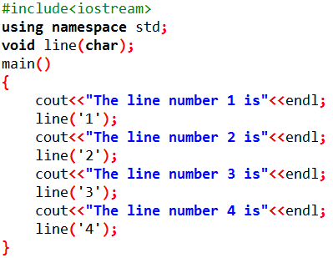
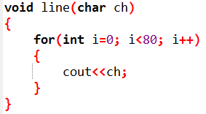
Execution with Functions
Whenever a function is called the execution control is transferred to the function and then transferred back to calling program

Slide 7
Inline Functions
A function call transfer the control from calling program to the function
After the execution of function the control is transferred back to calling program
This may be time consuming and valid for large functions
If a function is short we wish to place the code of function inside the calling program in order to save time and these functions are called inline functions

Slide 8
Inline Functions
If a function is inline, the compiler places a copy of the code of that function at each point where the function is called at compile time
Any change to an inline function could require all clients of the function to be recompiled because compiler would need to replace all the code once again otherwise it will continue with old functionality
To inline a function, we place the keyword inline before the function name and define the function before any calls are made to the function
The compiler can ignore the inline qualifier in case defined function is more than a couple of lines

Slide 9
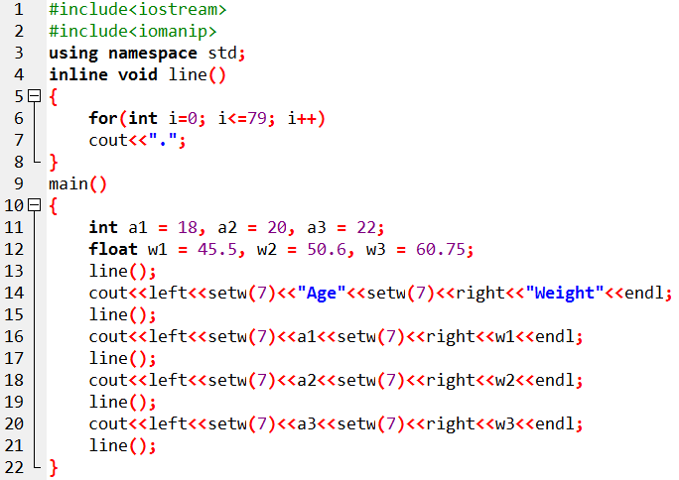
Inline Function – Example

Slide 10
Analysis of Inline Function
If a function is defined as an inline function then the compiler places a copy of function at each calling point so:
Compilation time increases
Output file size increases
Execution time decreases

Slide 11
Recursive Functions
A recursive function is a function which keeps on calling itself until a specific condition is true
The condition at which the recursive function exit is called base case
A recursive function has:
A base case
A way of getting the problem close to base case
A recursive call which passes the simpler problem back to the function

Slide 12
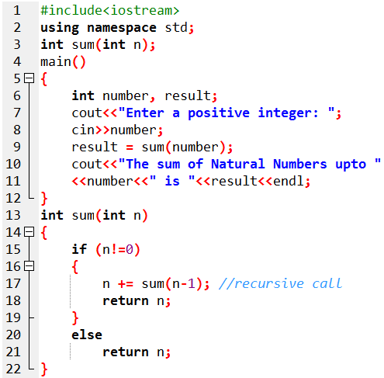
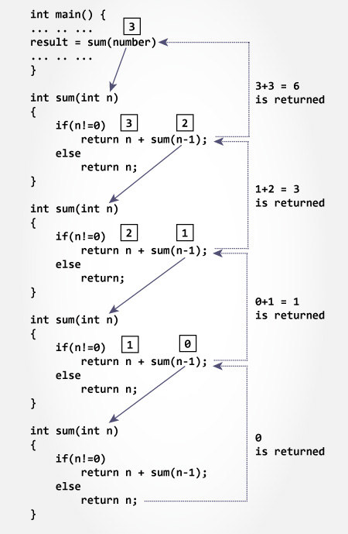
Recursive Function (Example & Working)
We have analyzed the working of recursive function when user entered 3, Now construct a diagram for the case when user entered 5 (write the recursive calls and return values along with direction).

Slide 13
Recursive Functions – An Analysis
Recursive functions make the program cleaner and tends to give more accurate answers as compared to iterative structures
Whenever the recursive function calls itself, it allocates the memory to newer version of function and also to the variables
So it makes the recursion inefficient in terms of memory and speed

Slide 14
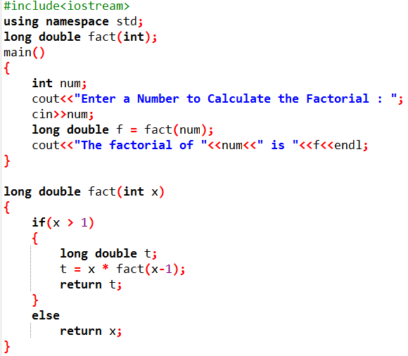
Practice Problem 1
Write a program to calculate the factorial of a number entered by the user by using recursion.

Slide 15
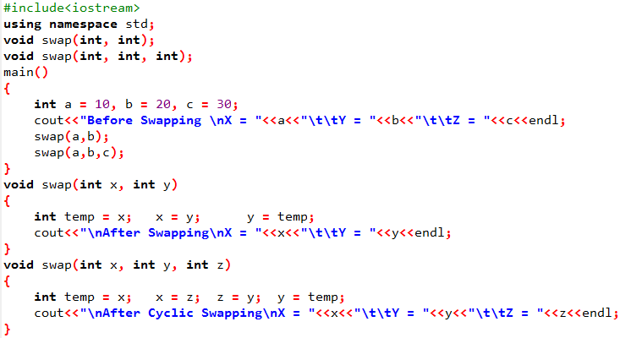
Practice Problem 2
Write a program to swap or cyclic swap the integers. If user passes 2 integers, then just swap them, and if user passes 3 integers, then clock wise cyclic swap them.
You are not allowed to use any conditional structure ☺

Slide 16
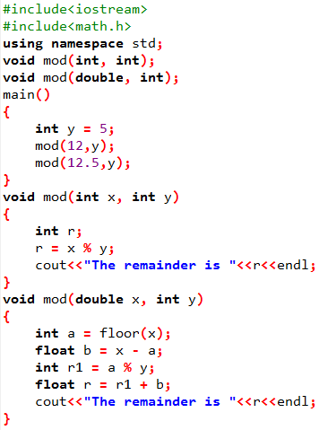
Practice Problem 3
You know that modulus operator (%) can only work with integer data types. But you still want to compute the remainder of any number after division with 5.
Write an efficient program to compute the remainder in each case, either user enters an integers or float.
You are not allowed to use any conditional structure ☺

